Slide 1
Smart Parking System
Forest Li
Jianjun Wei
Wenxuan Zhu

Slide 2
Brief Intro
Vehicle Access Management
License plate recognition
Vehicle recording
Fare calculation
Parking barrier
Parking Guidelines
Parking space management

Slide 3
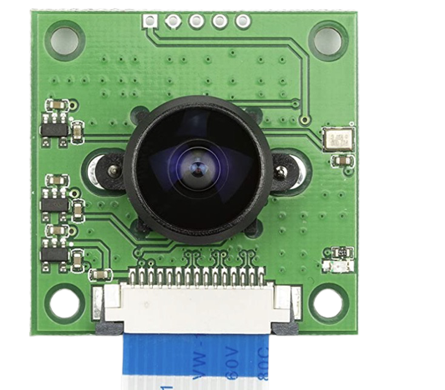
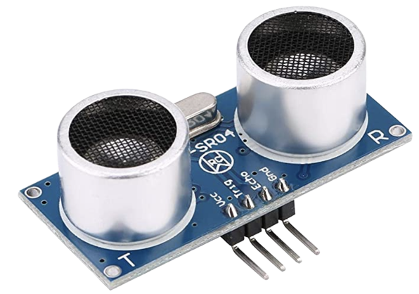
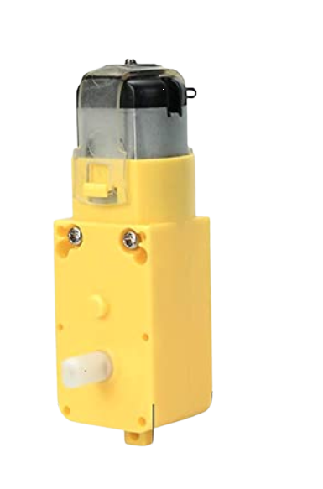
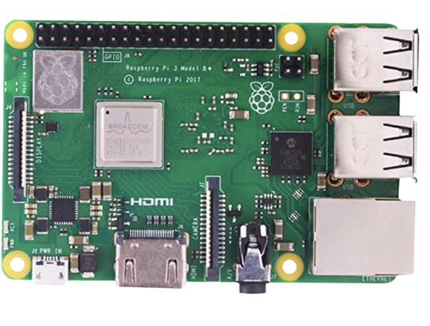
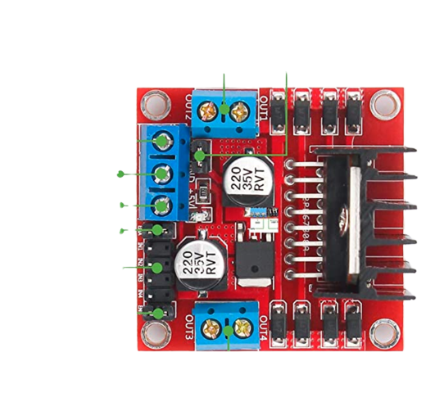

Equipment
Raspberry Pi
Distance Sensors
Camera
AWS Platform
L298N and Electric motor
Resistor

Slide 4
Structure
Amazon Recognition
AWS S3 Bucket
AWS Lambda
Screen
Raspberry Pi
AWS IoT
DynamoDB
distance sensors
Camera

Slide 5







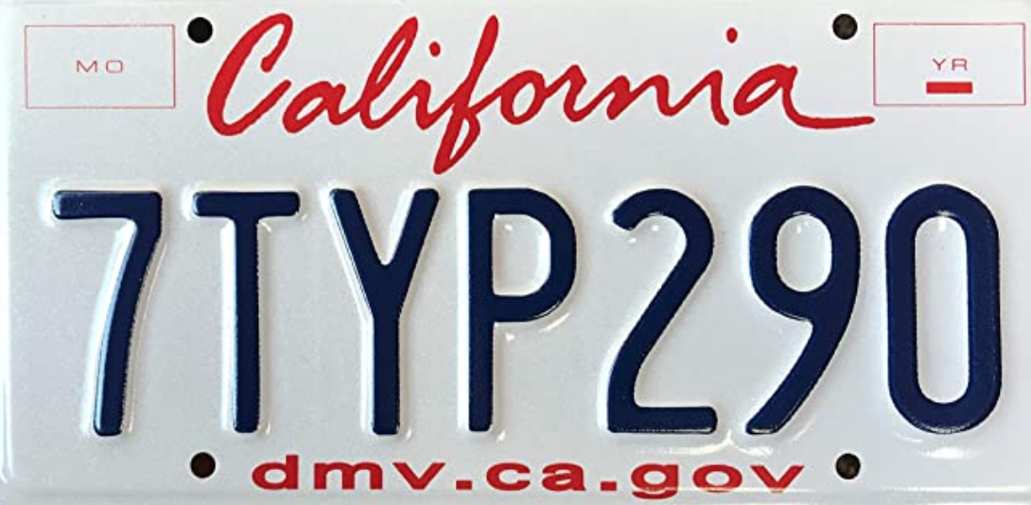
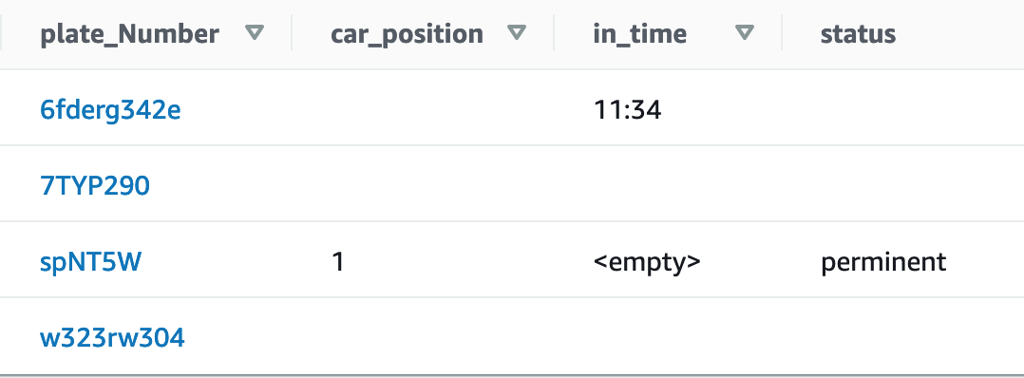
5ALN015
Permanent
Temporary
Check parking spot
Update in/out time
Assign parking spot
Record in/out time
Calculate parking fee

Slide 6
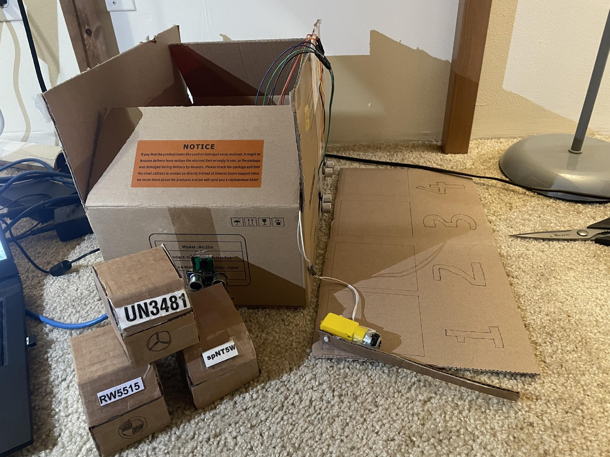
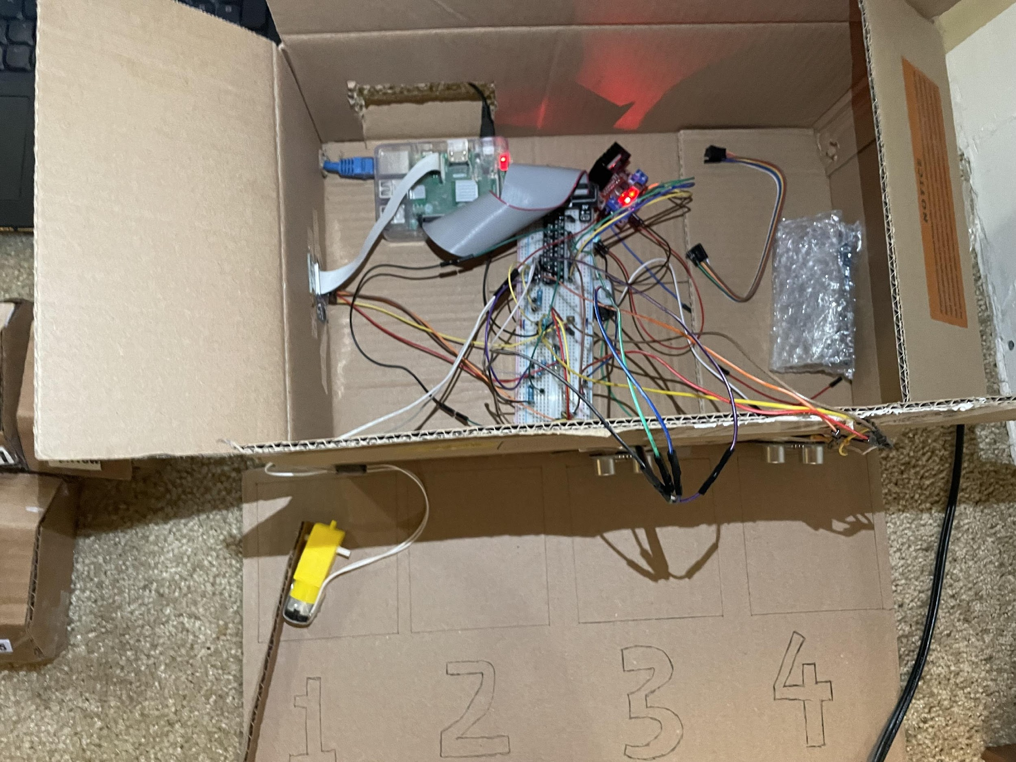
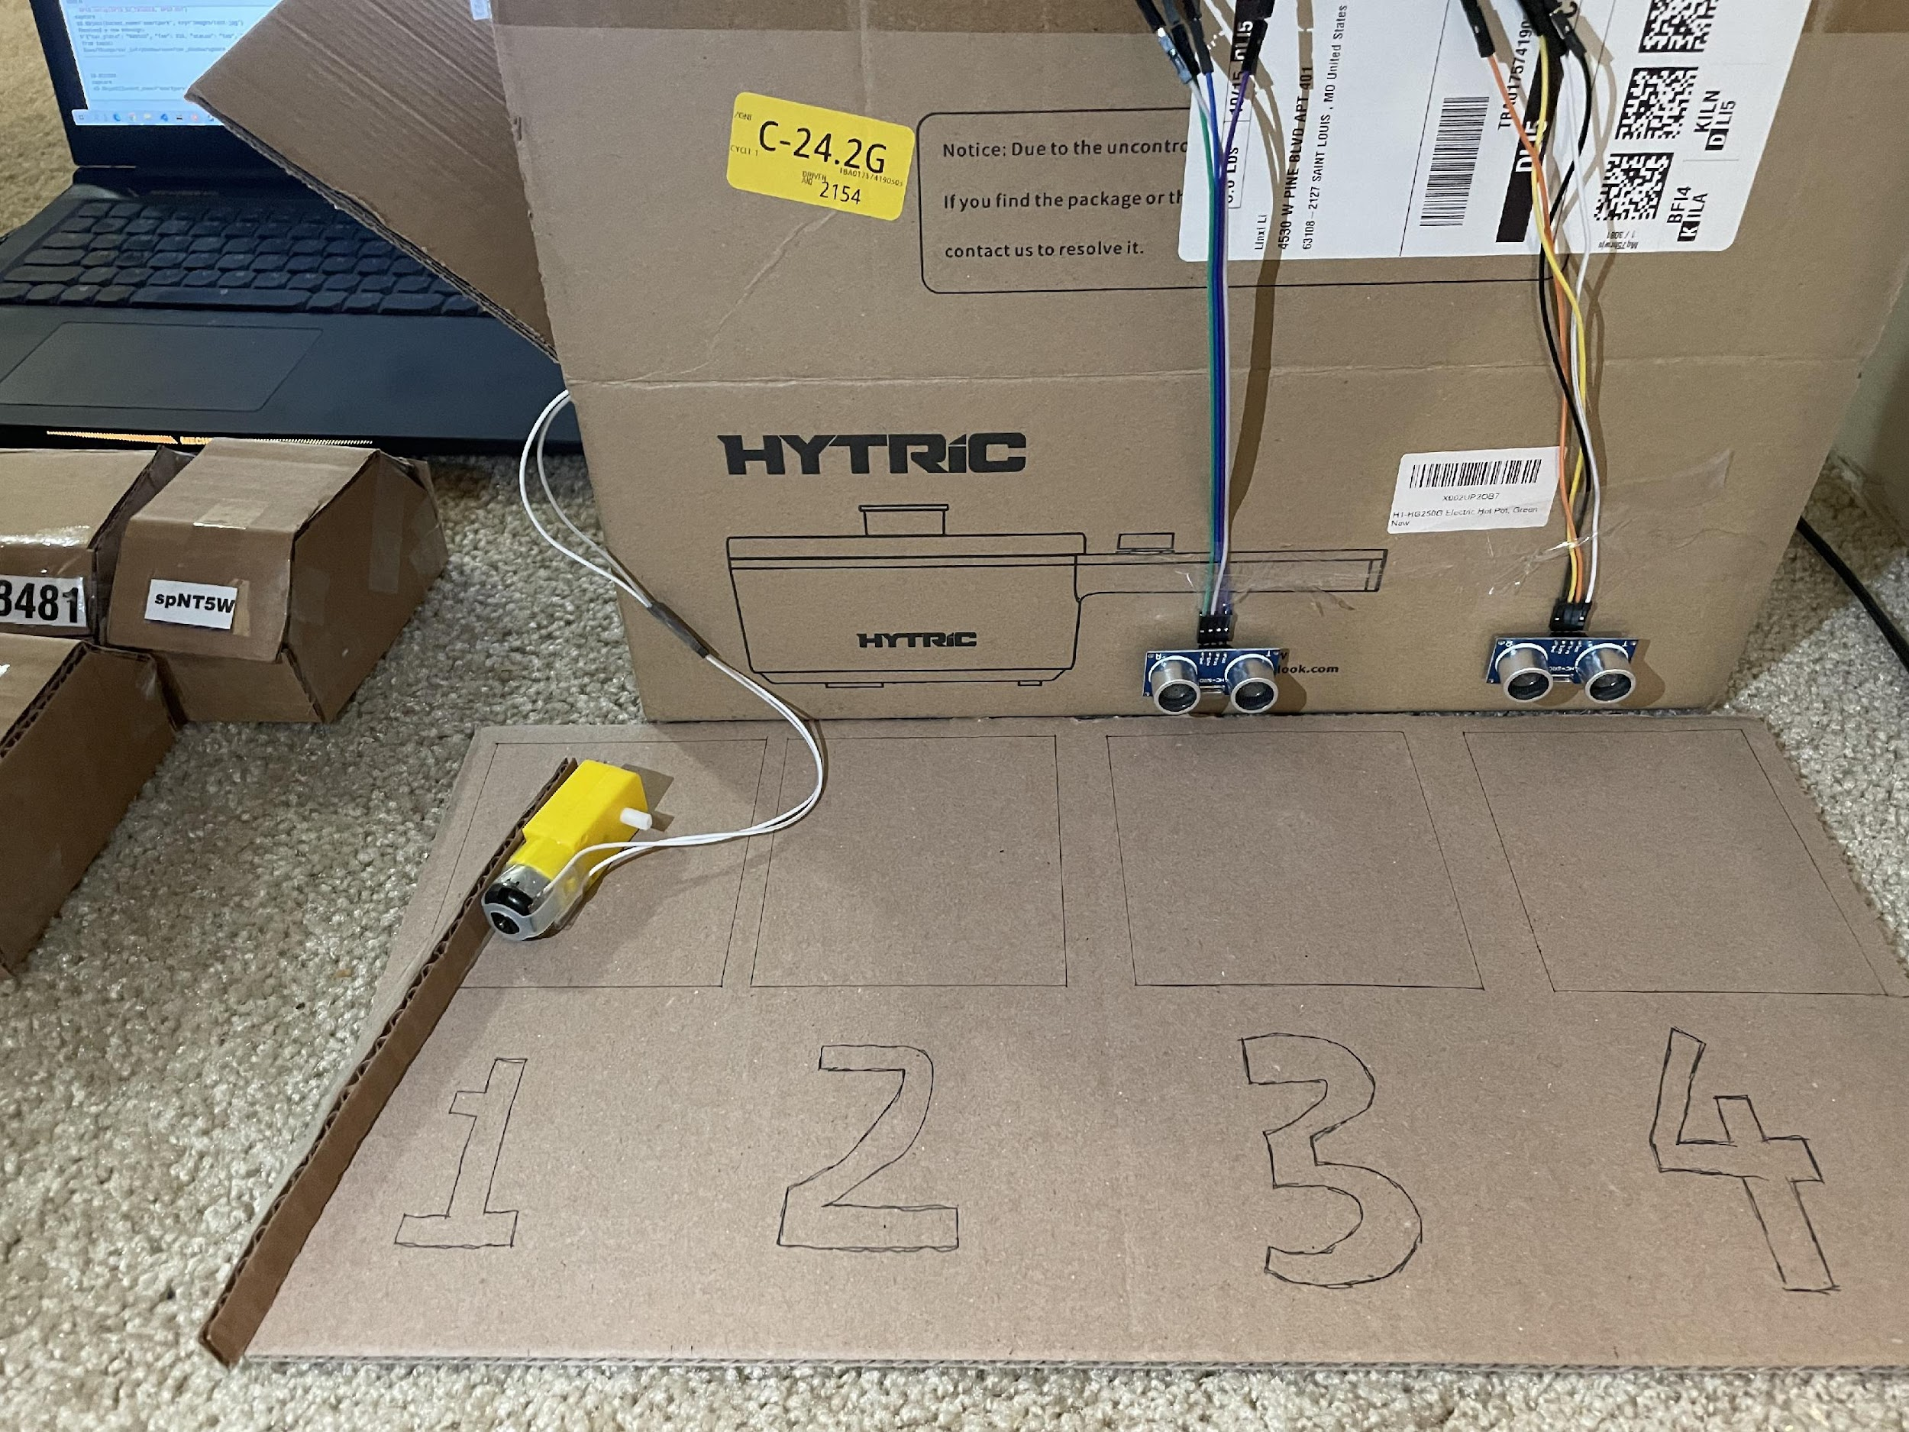

Slide 7


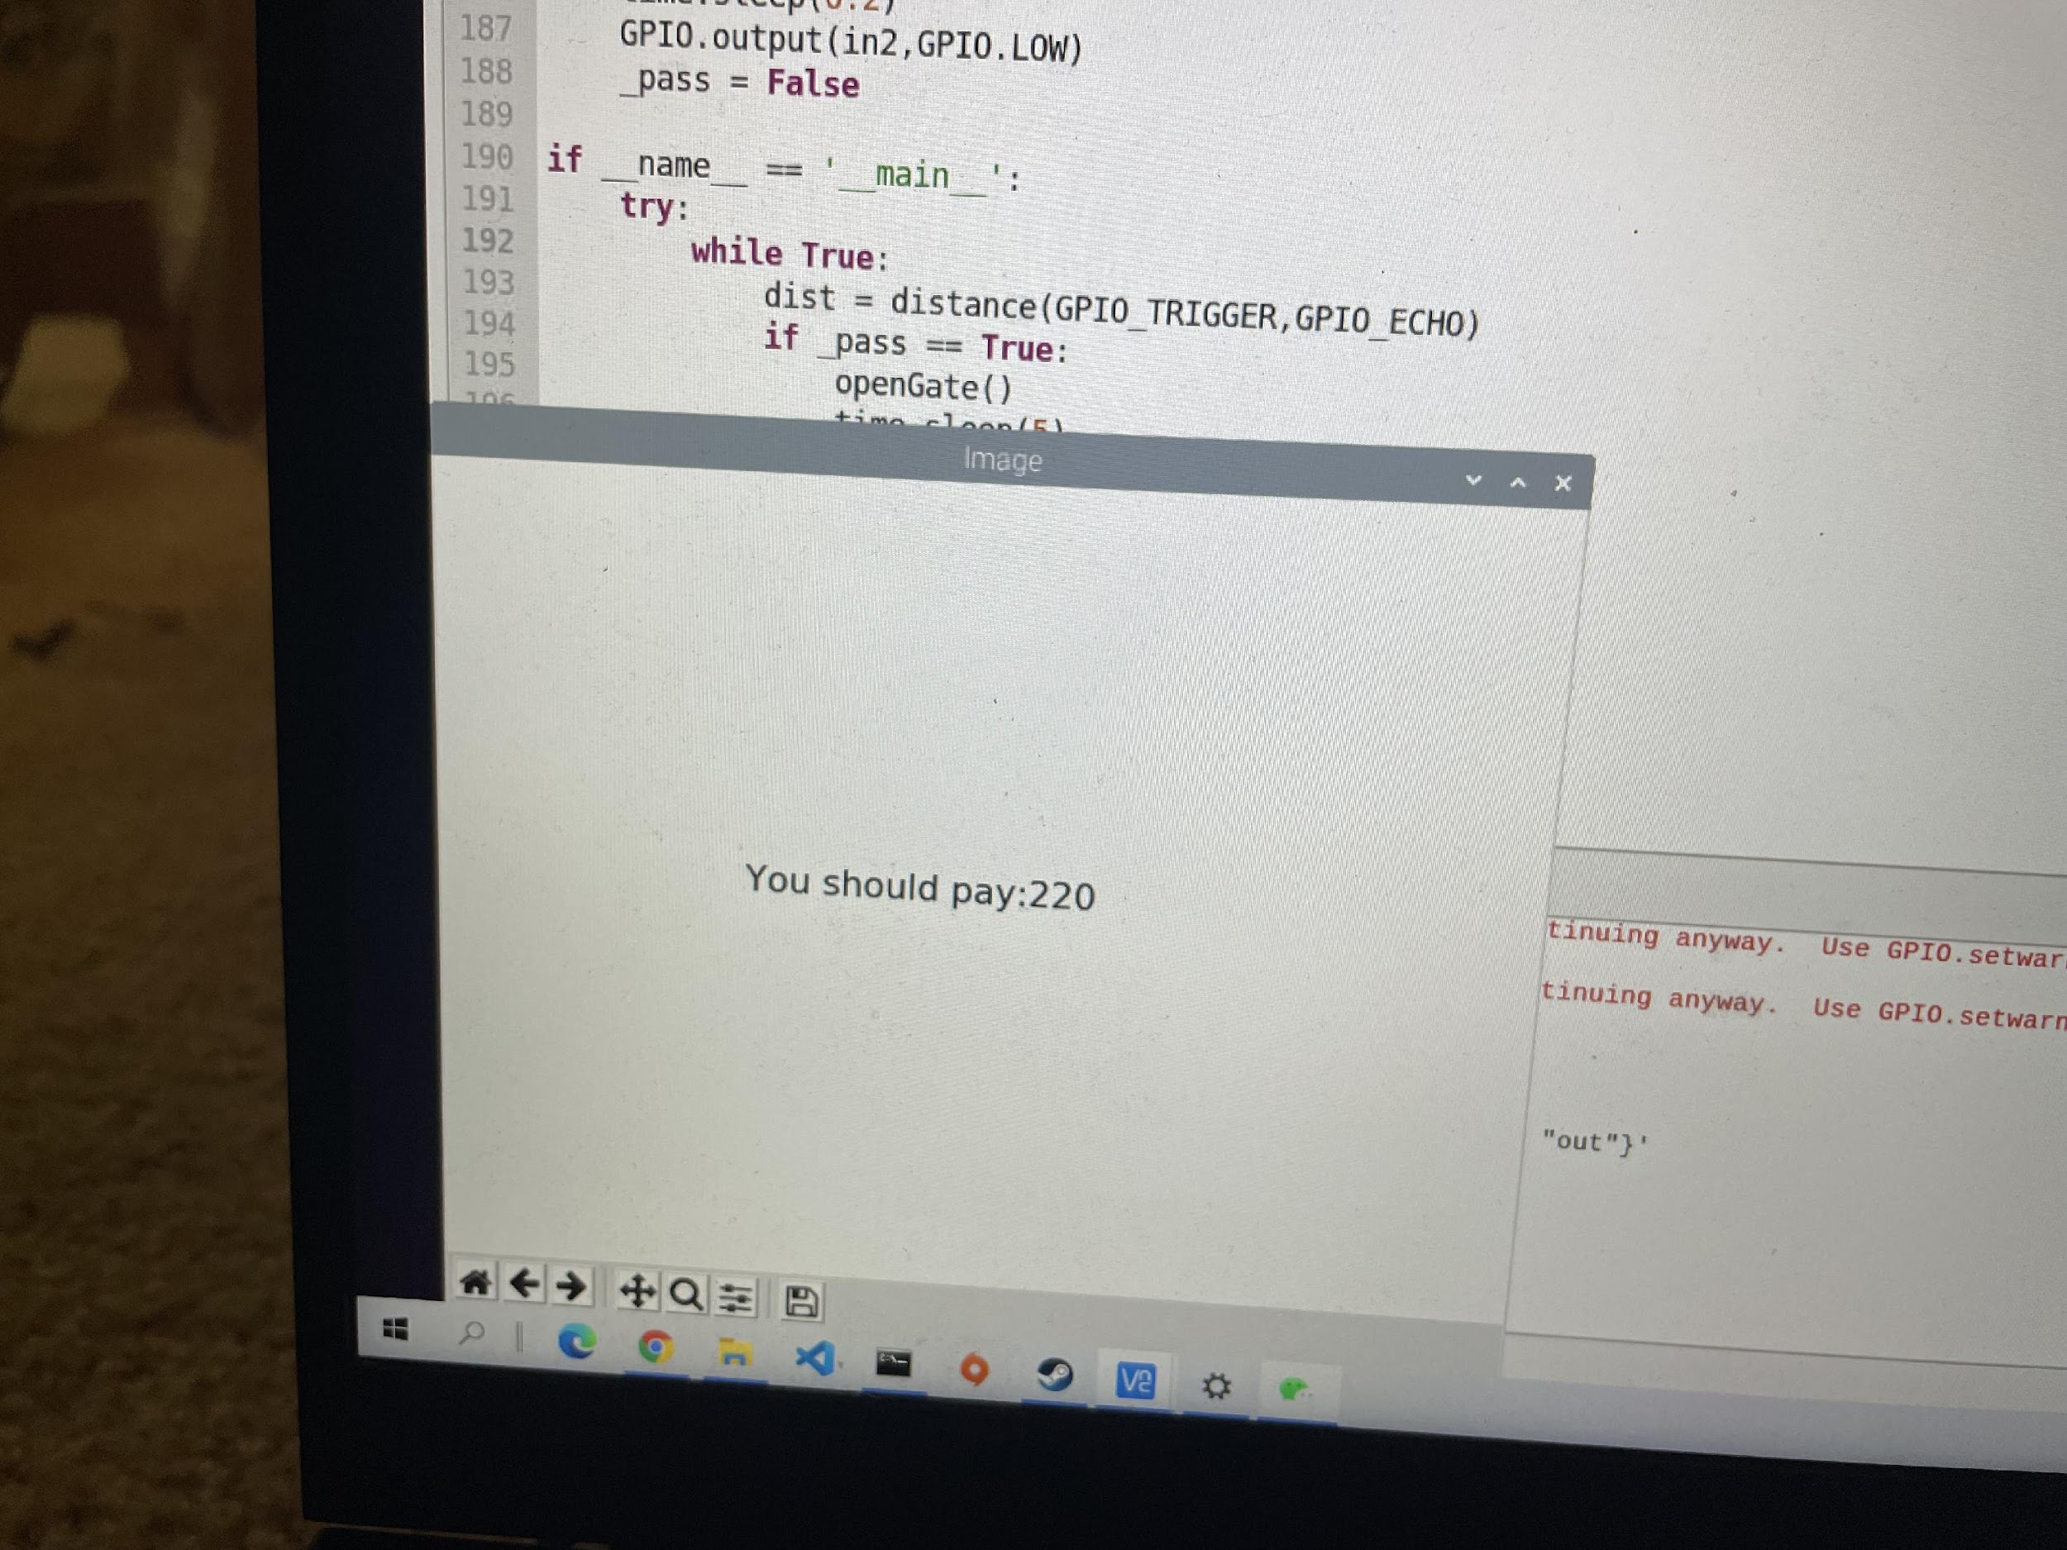






Slide 8
Text Recognition | Data processing | Data transfer | Time
0.91 | 1.03 | 6.2 | 7.22
0.87 | 1.19 | 6.6 | 8.1
1.44 | 0.59 | 5.88 | 7.98
1.8 | 0.54 | 7.22 | 7.95
0.87 | 0.55 | 4.27 | 5.01
0.88 | 0.56 | 5.44 | 6.92
0.84 | 0.56 | 5.77 | 5.9
0.9 | 0.83 | 5.34 | 6.05
0.92 | 0.53 | 4.28 | 5.04
0.95 | 0.82 | 4.44 | 5.25

Slide 9
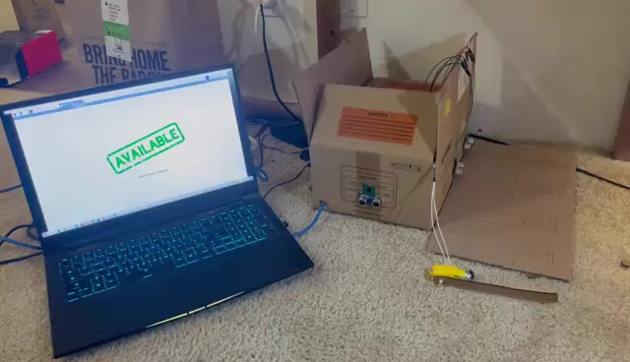

Slide 10
Thanks for Listening

